Slide 1
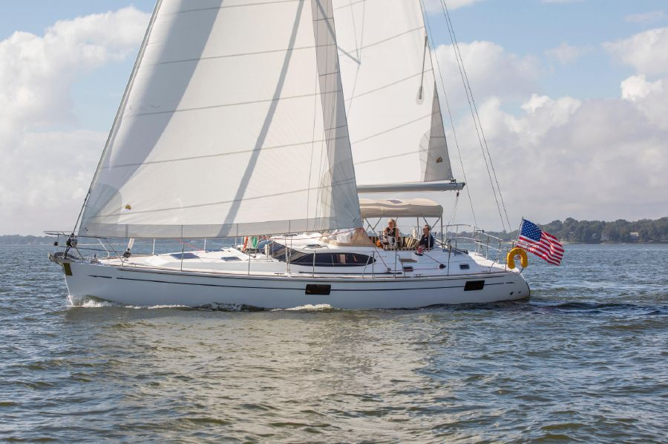
Metis Project 2: Scraping & Regression
Midsized Sailboat Valuations
By Sean Davern
Notes:
Many people love boating. I love sailing. To me, sailboats are the manifestation of physics in practice.
Weather you’re buying or selling a boat, or you own a boat and are contemplating one of the endless projects you might need to do, or just dreaming about what it might be like to one day sail off into the sunset and wondering what that might cost, you might want to know what they cost…

Slide 2

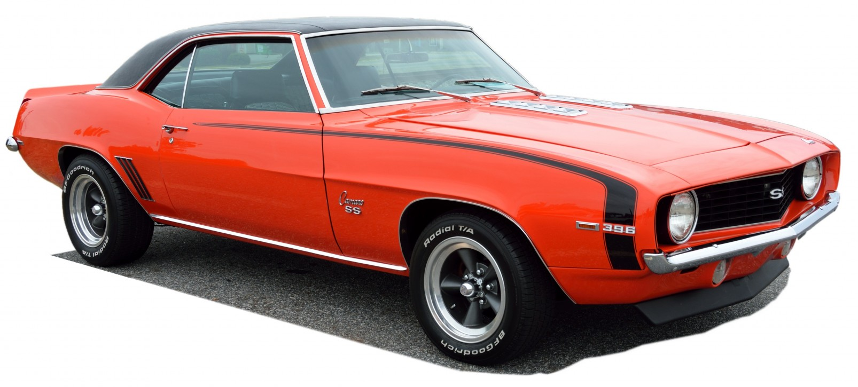

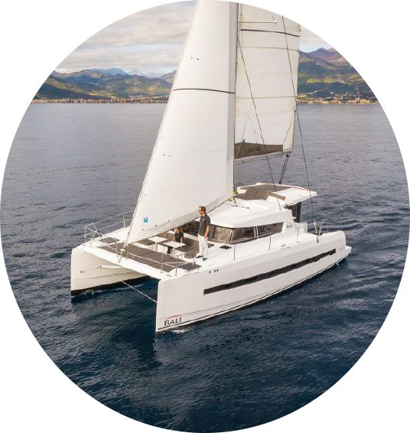
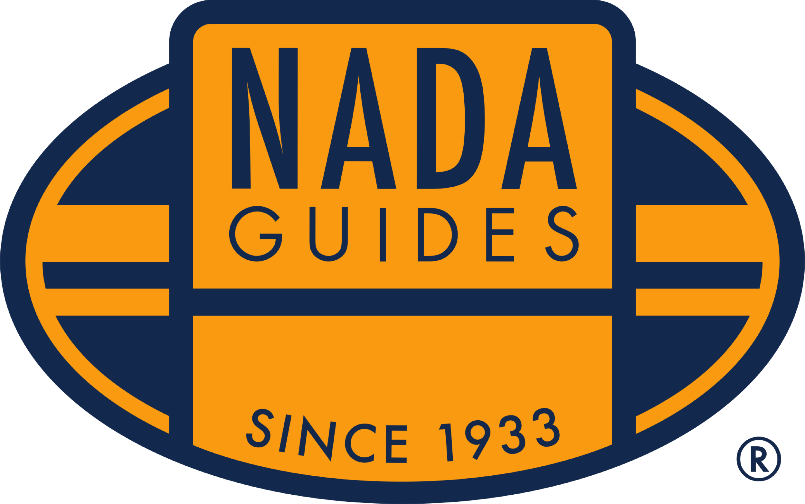
Individual Item Based Estimation
Make,
Model,
Year,
etc.
Make,
Model,
Year,
etc.
Notes:
Valuations can be done a number of ways:
Surveyor

Slide 3

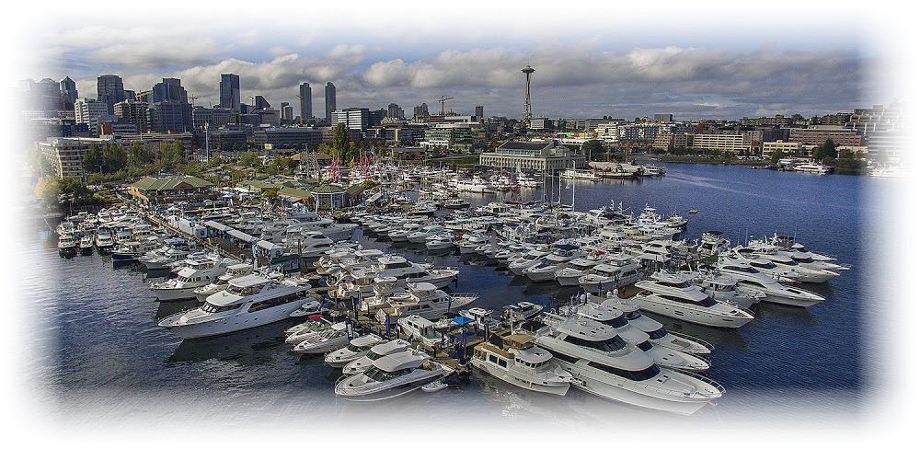
Surveying the Market

Slide 4
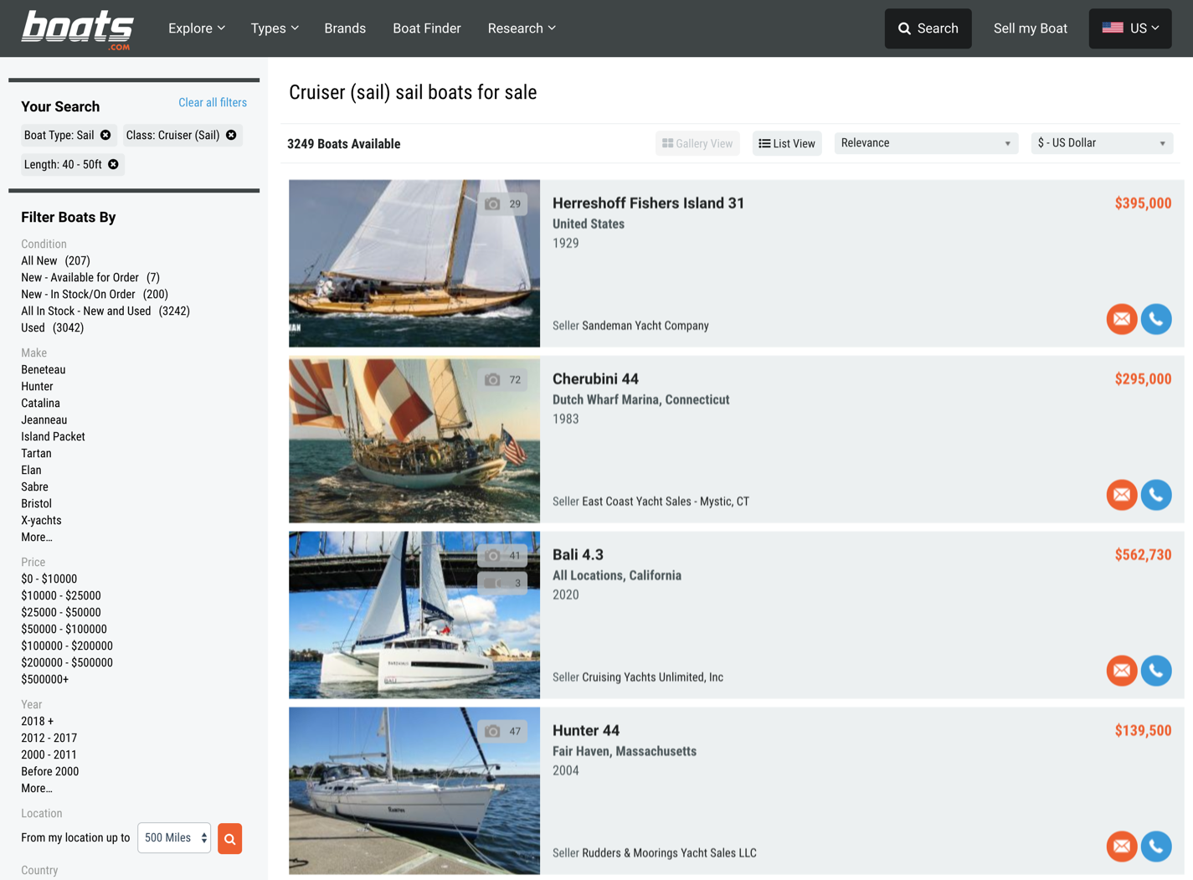
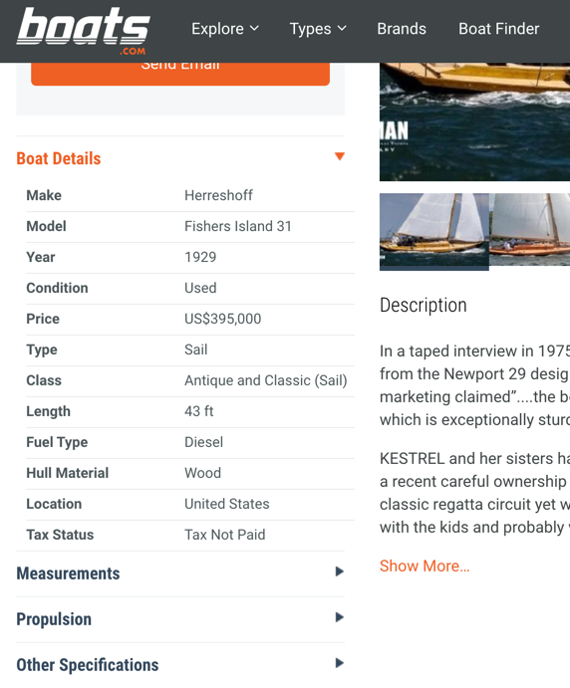
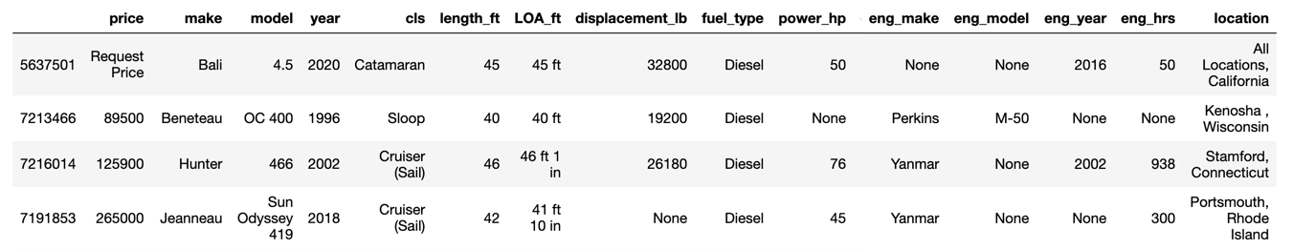
Gathering Data

Slide 5
MVP

Slide 6
Model Status Quo

Slide 7
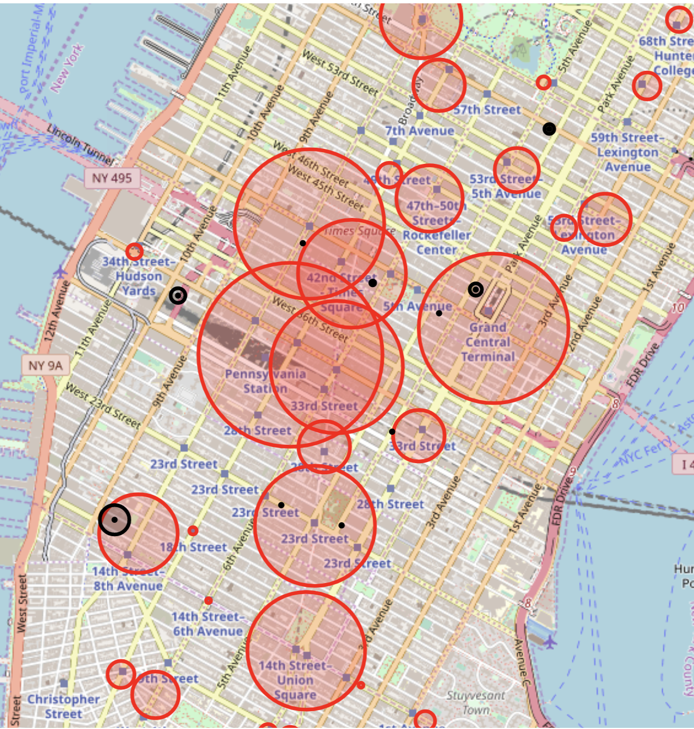
Results
High Traffic + Near Tech Hubs
Grand Central
High Traffic + Near Tech Hubs
86th St
Notes:
Subway Station Traffic: by Average Daily Turnstile “Entrances”
Technology Companies (sample of 15 locations): by square footage
Technology Schools (NYC, CUNY [New York City College of Technology, NYIT]): by student population size
Assumptions of using Subway Traveler Volume:
Every subway rider has an equal likelihood of attending & contributing
Weekly commuter patterns in Spring 2019 are consistent with Spring 2020
To address the limitations of relying on the MTA data alone, we looked to multiple sources to identify the “Tech Hubs”
Using the locations of the stations and the “Tech Hubs”, we were able to narrow our results
Preliminary results:
Here are some preliminary results we found, as a taste of what we can do.
Most overall traffic:
Let’s start at the start and simply see where the most traffic is. This has a lot of assumptions baked into it, so we’ll examine these and refine our recommendations as we continue.
Top five stations in terms of average daily turnstile entrances:
34th St - Penn Station
42nd St - Grand Central Station
34th St - Herald Square
14th St - Union Sq
42nd St - Times Sq
[make a table or chart to put here instead of list]

Slide 8
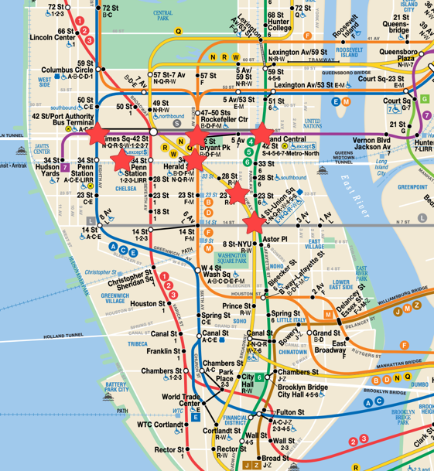
Recommendations
Street Teams Work:
At these stations:
34th St Penn Station
42nd St - Grand Central Station
42nd St
34th St - Herald Square
23rd St
14th St - Union Sq

Slide 9
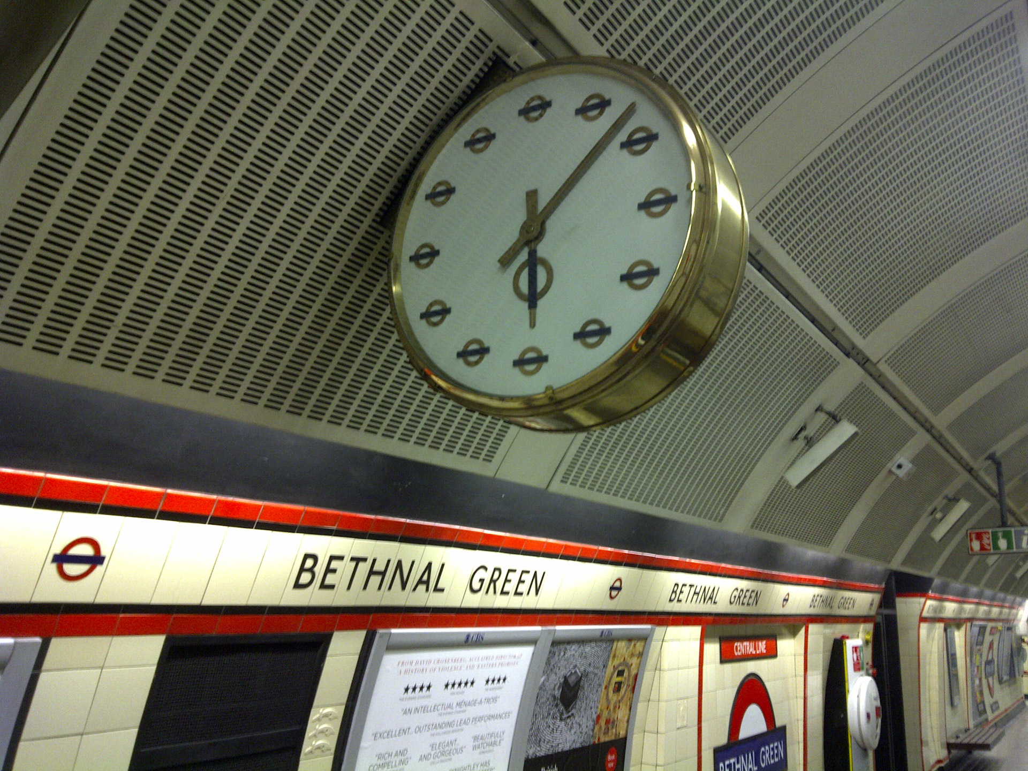
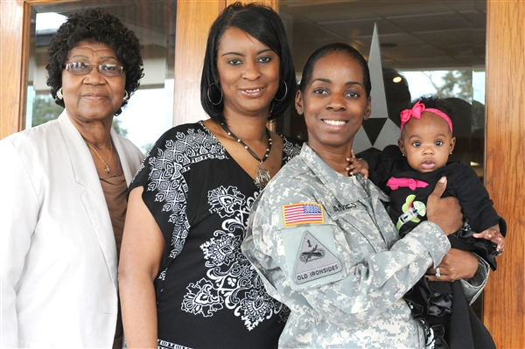



Future Work
Days / Times
Target
Specific
Areas
Demographics
Tech
Companies

Slide 10
Appendix

